Slide 1
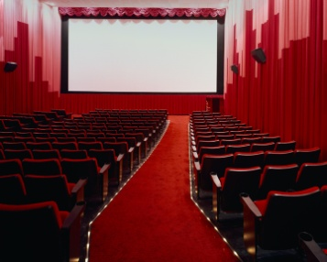
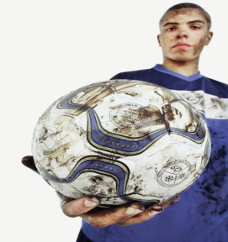
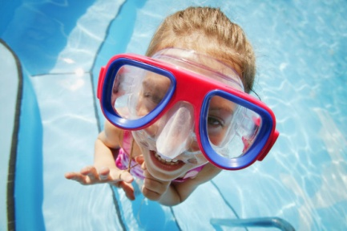
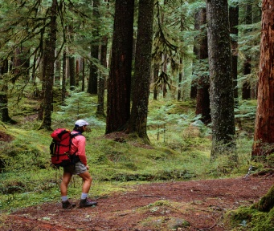
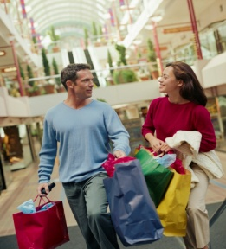
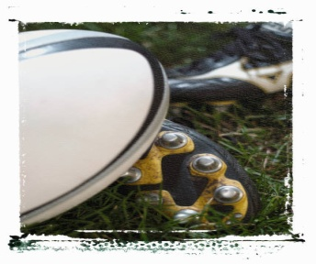
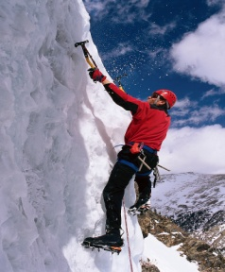
Ma ville idéale
Jeudi, 2 avril
Objective:
To create a poster advertising our ideal town.

Slide 2
Qu’est-ce qu’il y aurait dans ta ville idéale?
Dans ma ville idéale, il y aurait...
Dans ma ville idéale, il n’y aurait pas de...
Make a poster that shows what you would (or wouldn’t) have in your ideal town. Use the pictures provided or draw your own. Make sure you label all the buildings in your town.
Extra: Say where it would be, what would be in it, what you could do there and what it would be like. Use the vocab sheet to help you.

Slide 3
Ma ville idéale
Ma ville idéale serait ... (en Angleterre? A la montagne?)
Dans ma ville, il y aurait ... (un stade?)
On pourrait... (faire la natation?)
Ce serait ... (animée?)

